Slide 1
Linear Regression

Slide 2
Linear Regression
Simple to implement & efficient to train.
Overfitting can be reduced using regularization
Performs well when the dataset linearly separable
Assumes that the data is independent which is rare in real life
Prone to noise & overfitting
Sensitive to outliers

Slide 3
Types of Linear Regression
1. Simple Linear Regression
2. Multiple Linear Regression

Slide 4
Simple Linear Regression
Involves only one independent variable and one dependent variable.
y=C​+m​X where:
Y is the dependent variable
X is the independent variable
C is the intercept
m is the slope

Slide 5
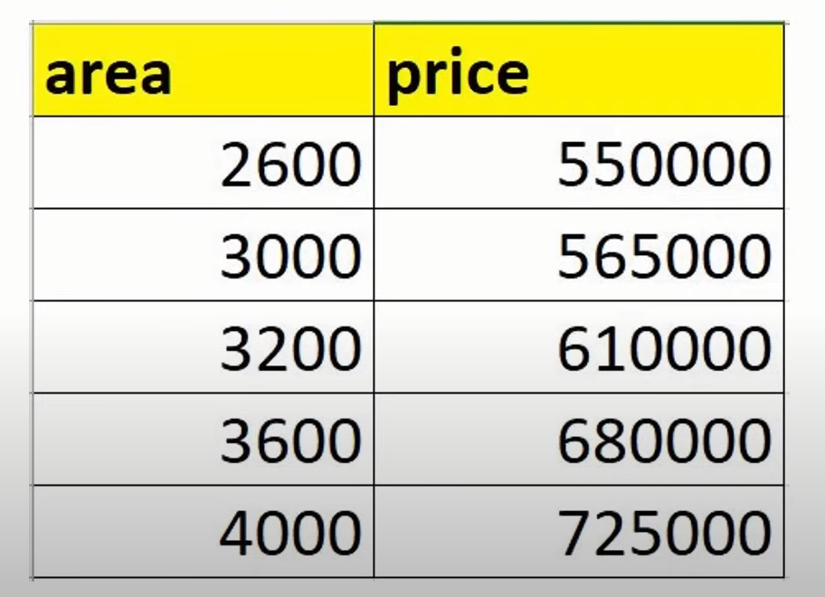
Simple Linear Regression

Slide 6
Applications of Simple Linear Regression
Estimating an employee's salary based on their years of experience.
Predicting the number of defective items in a manufacturing process based on a single predictor like machine operating hours.
Estimating calorie burn based on the duration of exercise
Predicting students' test scores based on the number of study hours.

Slide 7
Multiple Linear Regression
Involves more than one independent variable and one dependent variable.
y=β0​+β1​X+β2​X+………βn​X where:
Y is the dependent variable
X1, X2, …, Xp are the independent variables
β0 is the intercept
β1, β2, …, βn are the slopes

Slide 8
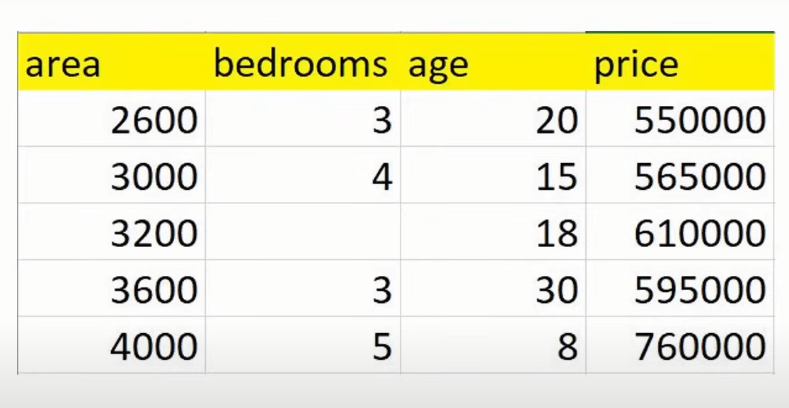
Multiple Linear Regression

Slide 9
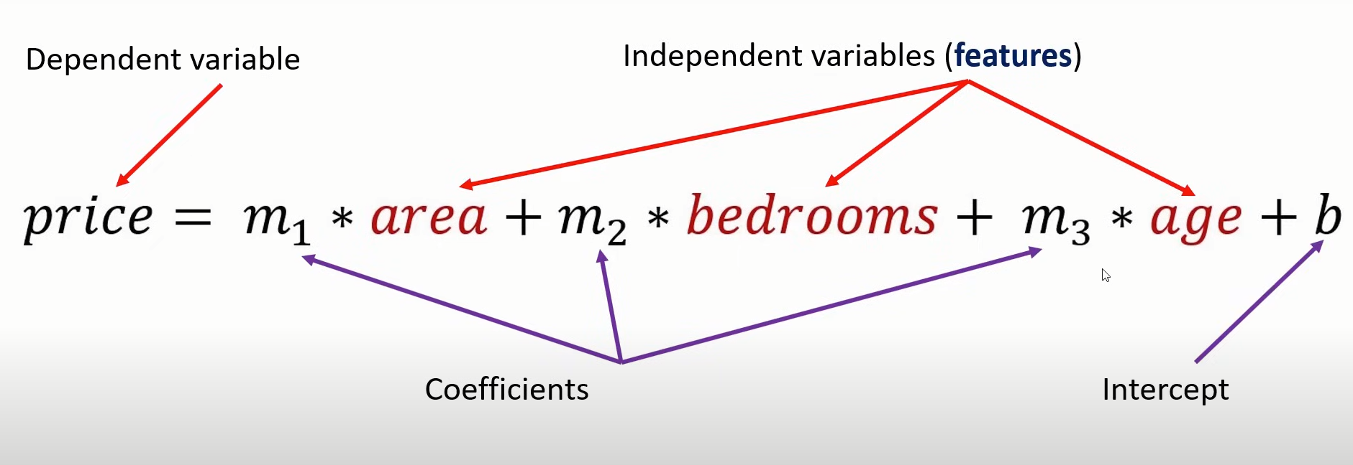

Slide 10
Applications of Multiple Linear Regression
Estimating the price of a house based on multiple features such as size, number of bedrooms, location, and age of the property.
Predicting patient outcomes based on multiple variables like age, weight, blood pressure, and cholesterol levels.
Analyzing customer satisfaction scores based on multiple predictors like service quality, product quality, and price.
Predicting traffic flow based on multiple variables like time of day, weather conditions, and roadwork status.

